Slide 1

A
Presentation on
“SORTING VISUALIZER
USING JAVASCRIPT”
By
Dr.S.V.Balshetwar
Aishwarya Anand Kumbhar
Rutuja Arjun Mane
Aarti Madhukar Palande
Muskan Hanif Shaikh
Name of College: YSPM’S Yashoda Technical Campus,Satara

Slide 2
01 INTRODUCTION
02 Tools
Agenda
03 Scope
04 System Architecture:
05 Modules and their functions
06 RESULT AND DISCUSSION
07 CONCLUSION

Slide 3
WHAT IS “SORTING
VISUALIZER” ?
Data structure and algorithms (DSA) is important field of Computer Science and Engineering.
Data structure related concepts are complicated to understand for learners so this project performs visualization of algorithms. It helpful for students to understand that how actually sorting methods work.

Slide 4



Tools
Visual Studio Code
Google Chrome
Languages
HTML
CSS
JavaScript

Slide 5
Scope
The main goal of this project was to create a teaching support software with visualization of the most known sorting algorithms and their variations. The application supports a graphic visualization of selected algorithms on randomly generated or manually created array, step-by-step execution possibility, pseudo code and current state of variables.

Slide 6
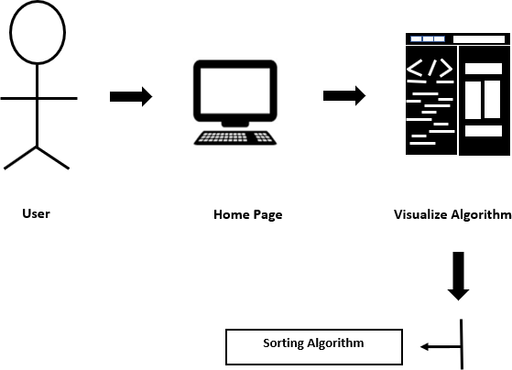
System Architecture:

Slide 7
Modules and their functions
1] Home Page:
User can see various sorting algorithm and its abstract information.
2] Bubble Sort Page:
Custom - To enter size of array and element of array.
Random - To generate bar of random element of array.
Size - To enter size of array in range up to 5-300.
Speed - To select speed of algorithm such as 1x, 2x, 4x, 8x, 16x, 32x.
Run Algorithm - Execution of bubble sort algorithm will start.
Reset - It can be used to generate default bars.
3] Insertion Sort Page
4] Selection Sort Page
5] Quick Sort Page
6] Merge Sort Page

Slide 8
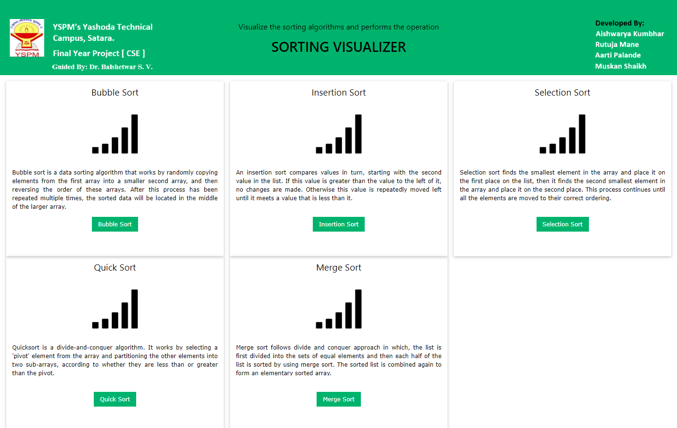
RESULT AND DISCUSSION
Home Page:

Slide 9
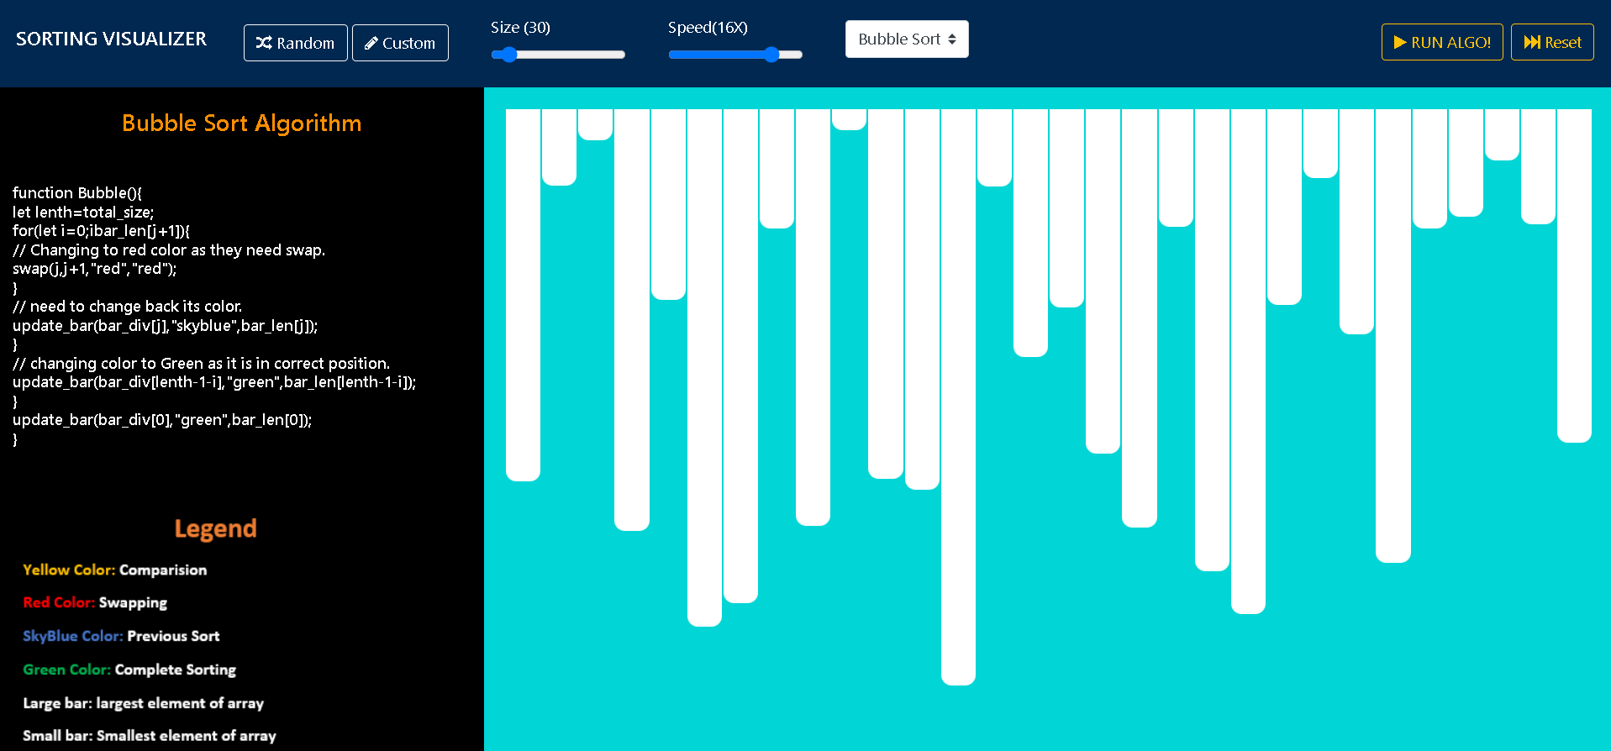
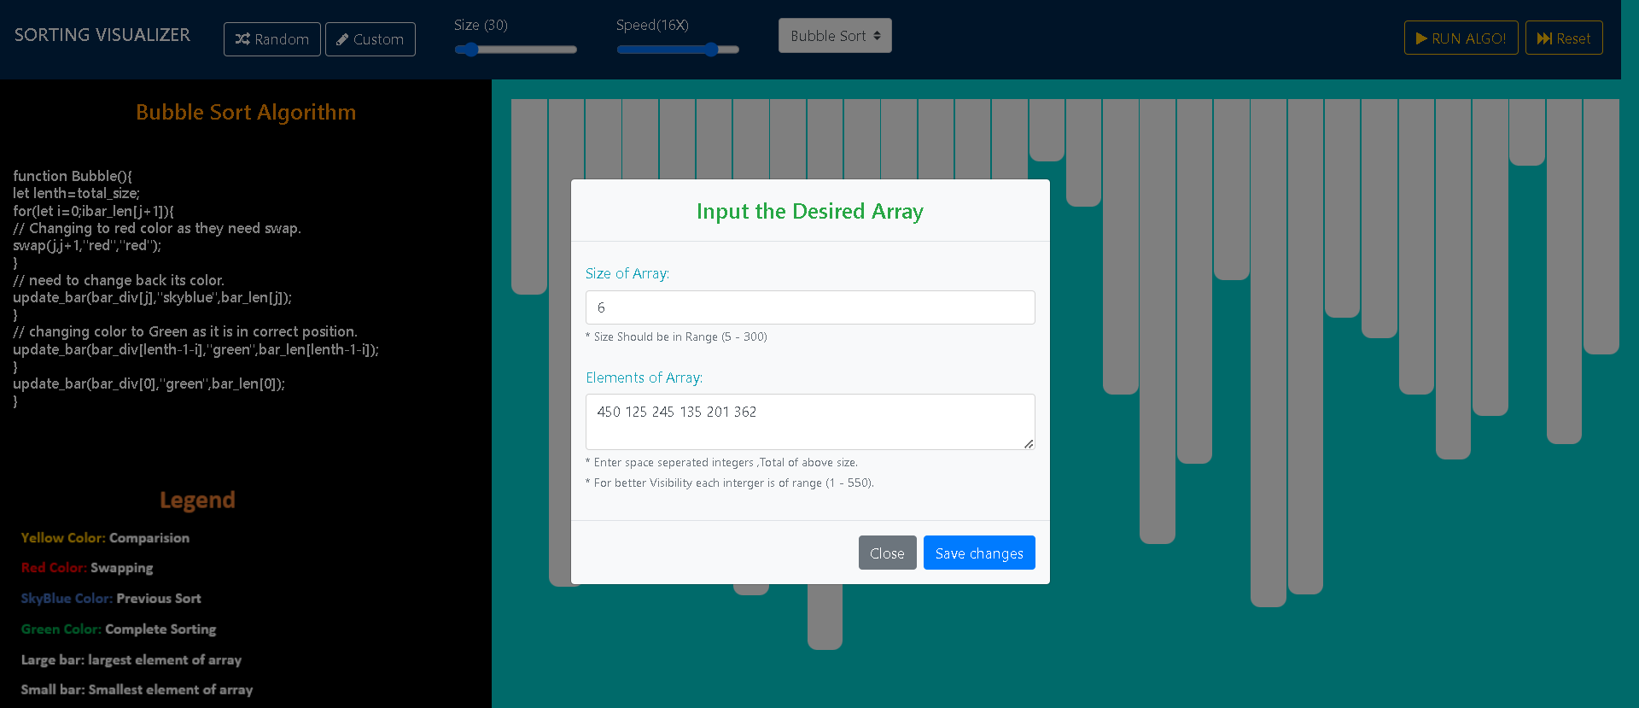
Bubble Sort:
Enter Elements of Array:
Fig : Bubble Sort
Fig :Enter Bubble Sort Elements

Slide 10
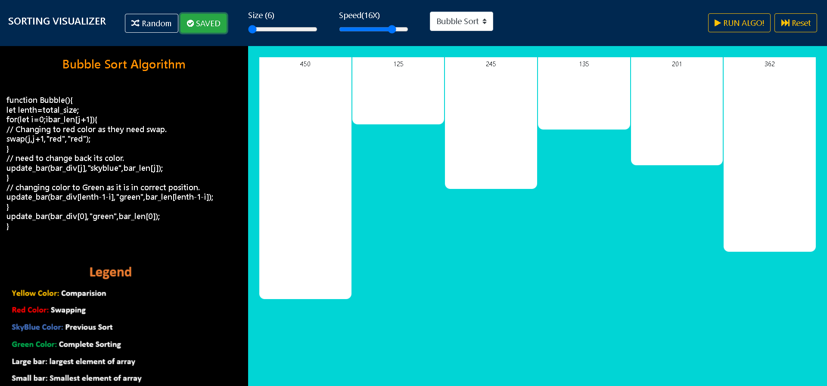
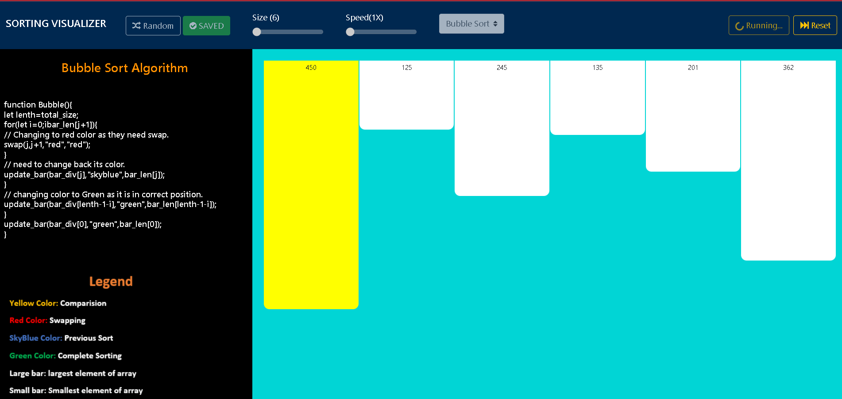
Generated Bars:
Fig 8.2.3 Generated Bars
Fig 8.2.4 Comparison Between Elements

Slide 11
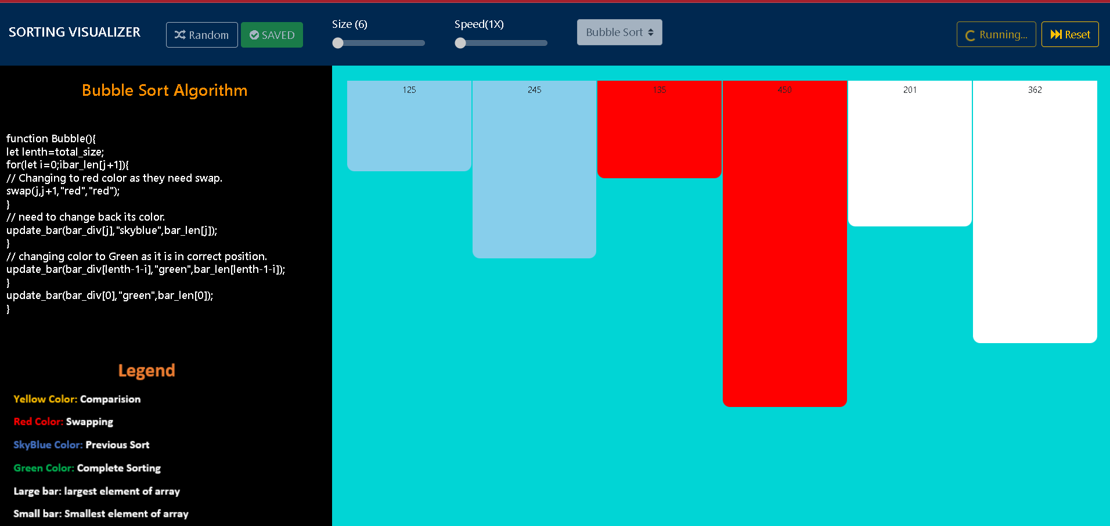
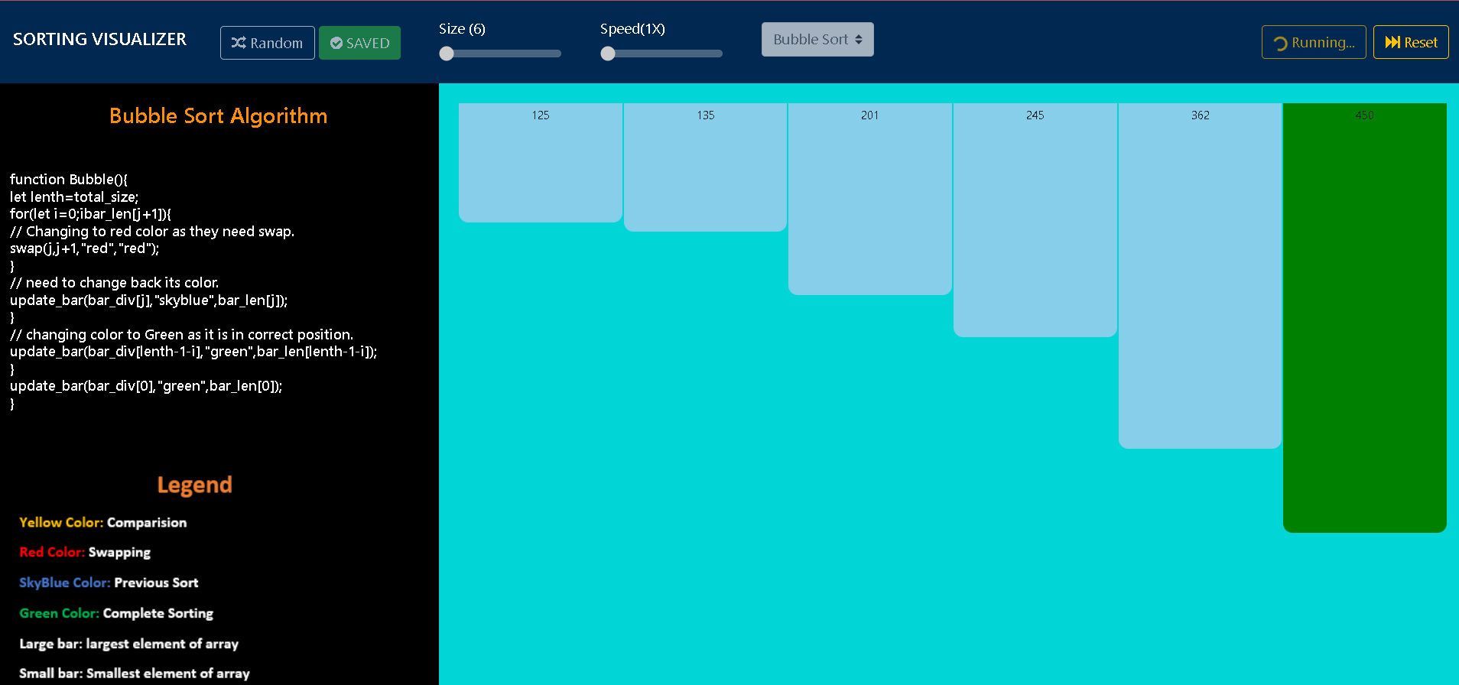
Swapping Between Elements:
Previous Sort:
Fig : Previous Sort
Fig :Swapping Between Elements

Slide 12
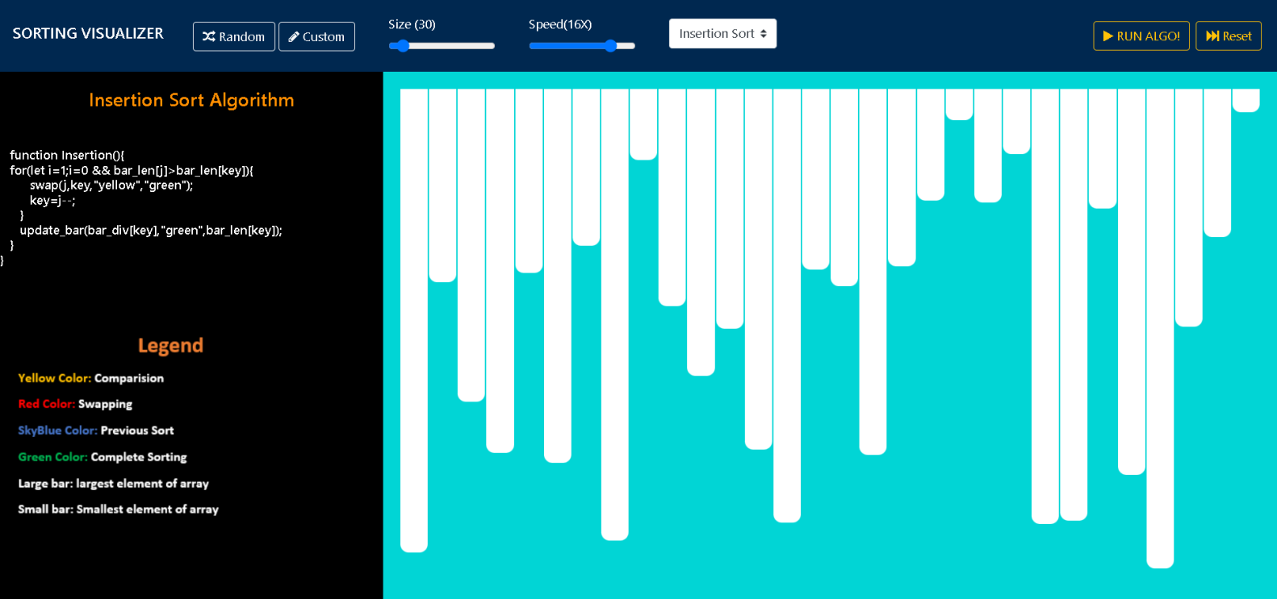
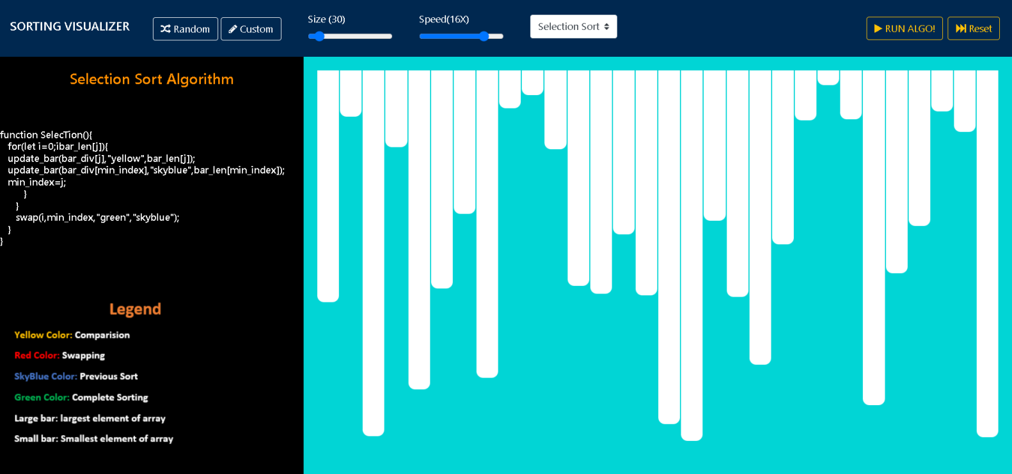
Insertion Sort
Selection Sort
Fig :Selection Sort
Fig : Insertion Sort

Slide 13
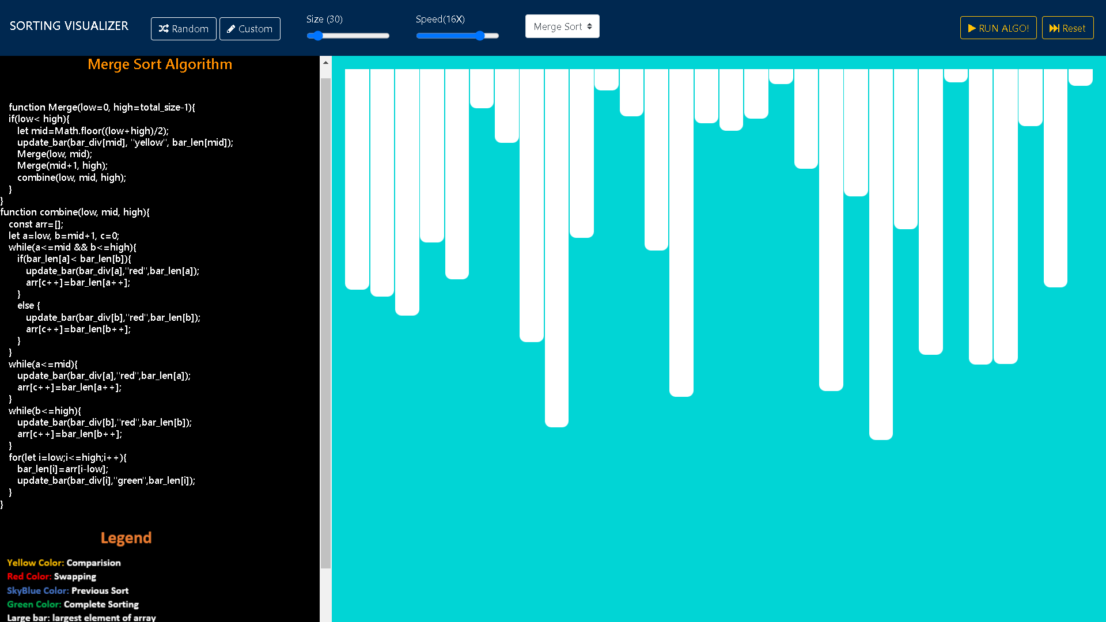
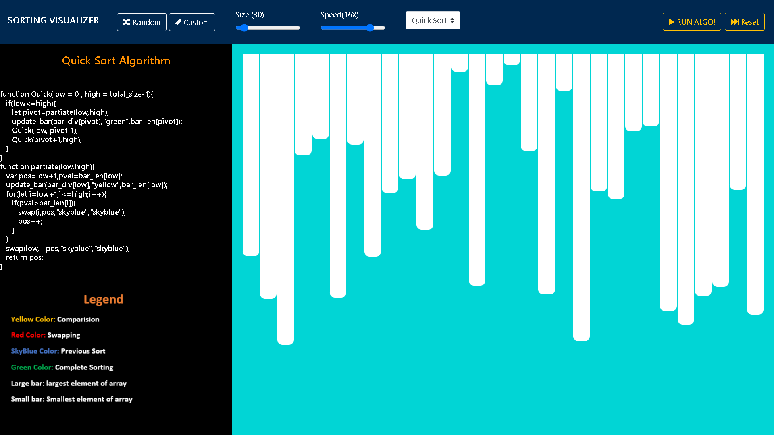
Quick Sort
Merge Sort
Fig 8.6 Merge Sort
Fig 8.5 Quick Sort

Slide 14

CONCLUSION
It Is Teaching Support Application
Easy-to-use
Interface

